Slide 1
Turing Machines- Introduction
-- Sakshi Surve

Slide 2
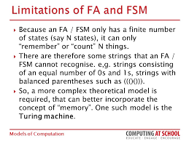

Slide 3
TM consists of ….
A head which can read or write a symbol or move to Left or Right or may stay in the same position.
An infinite tape on which the symbols can be written.
Finite set of symbols
Finite set of states in one of which the machine can reside at a time.

Slide 4
A Turing Machine :
Tape
......
......
Read-Write head
Control Unit

Slide 5
A Turing Machine (TM) has finite-state control (like PDA), and an infinite read-write tape.
The tape serves as both input and unbounded storage device.
The tape is divided into cells, and each cell holds one symbol from the tape alphabet.
There is a special blank symbol B.
At any instant, all but finitely many cells hold B….and the input string has B to its both sides
Tape head sees only one cell at any instant.
The contents of this cell and the current state determine the next move of the TM.

Slide 6
The Input String :
Input string
Blank symbol
......
......
head
Head starts at the leftmost position of the input string

Slide 7
The Tape :
No boundaries -- infinite length
......
......
Read-Write head
The head moves Left or Right or stays at the same position

Slide 8
......
......
Read-Write head
The head at each transition (time step):
1. Reads a symbol
2. Writes a symbol
3. Moves Left or Right or stays at same place

Slide 9
Example:
Time 0
......
......
Time 1
......
......
1. Reads a
2. Writes k
3. Moves Left

Slide 10
Time 1
......
......
Time 2
......
......
1. Reads b
2. Writes O
3. Moves Right

Slide 11
A Turing Machine performs following three actions before the next interval begins :
Square being read is erased and is replaced by another symbol
The internal state is changed
The head moves one square left, right or stays at the same position

Slide 12
This can be summarized in a string of the form
(q0 , a) → (q1 , b , L)
Where,
q0 = Current state
a = Input symbol read in q0
q1 = Next state
b = symbol ‘a’ has to be replaced with
L = The direction of movement of the tape head

Slide 13
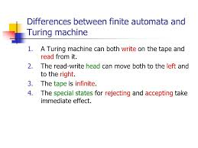

Slide 14
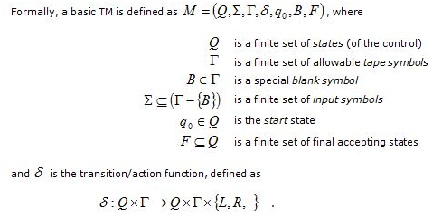
Representation of a Turing Machine :

